Slide 1
CSC 112: Computer Operating Systems Lecture 7 Memory System I: Cache
Department of Computer Science,
Hofstra University

Slide 2
Outline
Cache Introduction
Cache Organization
Cache Performance Analysis

Slide 3
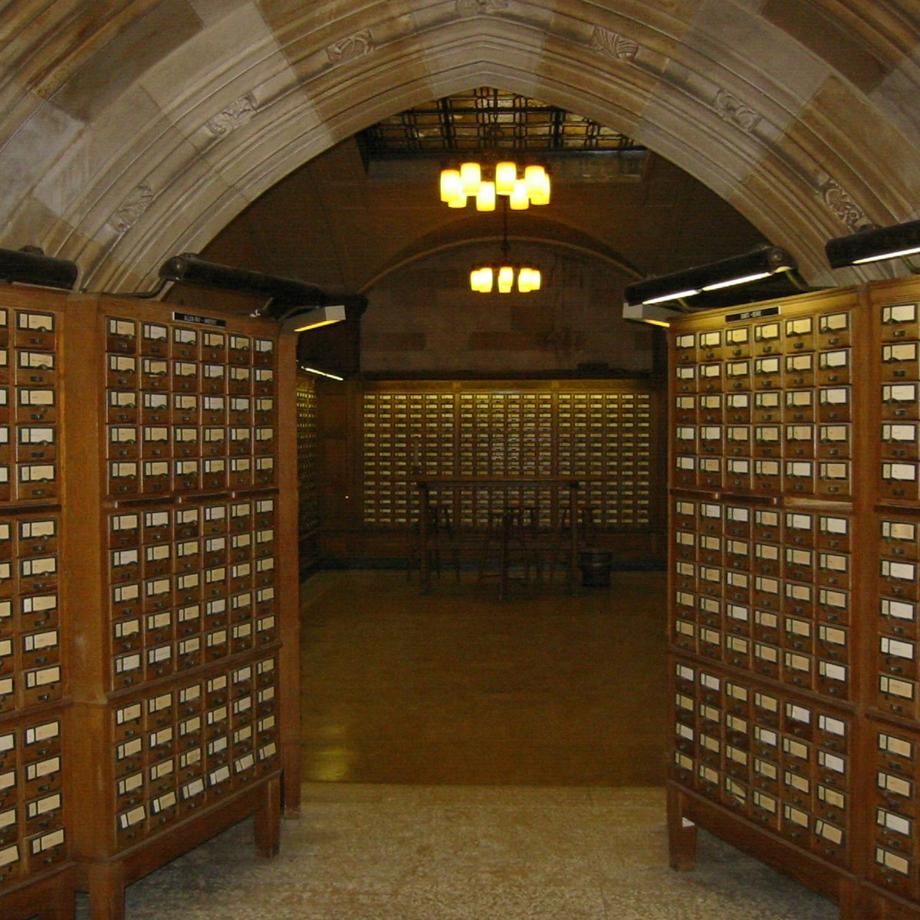

Why are Large Memories Slow? Library Analogy
Time to find a book in a large library
Search a large card catalog – (mapping title/author to index number)
Round-trip time to walk to the stacks and retrieve the desired book
Both delays become larger for larger libraries
Computer memories have same issue, plus the technologies used to store a bit slow down as density increases (e.g., SRAM vs. DRAM vs. Disk)
However, what we want is a large yet fast memory!

Slide 4
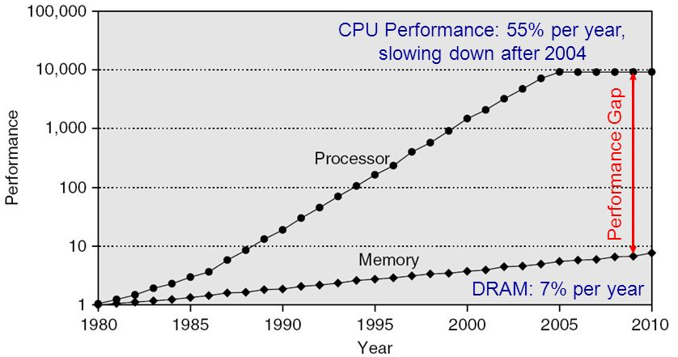
Processor-DRAM Gap (Latency)
1980 microprocessor executes ~one instruction in same time as DRAM access
2017 microprocessor executes ~1000 instructions in same time as DRAM access
Memory wall: memory access likely to be the performance bottleneck
4
Notes:
Why doesn’t DRAM get faster?

Slide 5
What To Do: Library Analogy
Write a report using library books
Go to library (main memory), look up relevant books, fetch from stacks, and place on your desk (cache)
If need more, check them out and keep them on your desk
But don’t return earlier books since might need them
You hope this collection of a few books on your desk enough to write report, even though they are a tiny fraction of all books in the library

Slide 6
Memory Hierarchy
Big, Slow Memory
(DRAM, Flash)
Cache
Small, Fast
(SRAM)
CPU
Registers
holds hot (frequently-used) data
Capacity: register << cache (typically on-chip) << memory (off-chip)
Latency: register << cache (typically on-chip) << memory (off-chip)
On a data access:
if data ∈ cache ⇒ cache hit ⇒ low latency access (SRAM)
if data ∉ cache ⇒ cache miss ⇒ high latency access (DRAM, Flash)
Goal: create the illusion of accessing as much memory as is available in the slow memory at the speed of the fast cache
Notes:
Due to cost
Due to size of DRAM
Due to cost and wire delays (wires on-chip cost much less, and are faster)
When accessing a memory address, one of two things can happen:
Cache hit: cache block is valid and refers to the proper memory address, so read from cache (fast)
Cache miss: cache block is invalid, or refers to the wrong memory address, so read from memory (slow)

Slide 7
Memory Hierarchy Technologies
Caches use SRAM (Static Random Access Memory) for speed and technology compatibility
Fast (typical access times of 0.5 to 2.5 ns)
Low density (6 transistor cells), higher power, expensive
Static: content will last as long as power is on
Main memory uses DRAM (Dynamic RAM) for size and density
Slower (typical access times of 50 to 70 ns)
High density (1 transistor cells), lower power, cheaper
Dynamic: needs to be “refreshed” regularly (every ~8 ms)
Consumes 1% to 2% of the active cycles of the DRAM
Processor
Inner
Increasing distance from processor, decreasing speed
Levels in memory hierarchy
Level 1
Level 2
Level 3
Outer
. . .
Level n
Size of memory at each level
As we move to lower levels, latency goes up and price per bit goes down.
Notes:
Size comparison: DRAM/SRAM is 4 to 8 times
Cost/cycle time comparison SRAM/DRAM is 8 to 16 times
http://parts.digikey.com/1/parts/1211303-ic-sram-1mbit-10ns-32soj-cy7c109d-10vxi.html
Quantity discount 10ns 1MBit SRAM $2.24, $17/Mbyte, $1700/100 Mbyte, $17000/GByte
http://www.frys.com/template/harddrives
DRAM: 4GB @ $70 or $17.50 per GB
24GB@$800 = $33/Gbyte
http://www.frys.com/category/Outpost/Hard+Drives+&+Memory/Memory/Notebook+Memory/Apple+-+Mac++Memory/
DDR2 1GB @ $25 per
DDR3 1 GB @ $37.5 per
FLASH Media
Approx. $2 per Gbyte

Slide 8
The Complete Memory Hierarchy
TLB: stores mappings of virtual addresses to physical addresses
PT: Page Table
Managed in Hardware
Managed in Software - OS
?
Processor
Secondary Storage (Disk)
TLB
PT
L2 Cache
Registers
L1 Cache
Secondary Storage (SSD)
PT
PT
Main
Memory
(DRAM)
PT
TLB
L3 Cache (shared)
L2 Cache
Registers
L1 Cache
Accessed in Hardware
Speed (ns):
0.3
1
3
10-30
100
100,000 (0.1 ms)
10,000,000
(10 ms)
Size (bytes):
100Bs
10kBs
100kBs
MBs
GBs
100GBs
TBs

Slide 9
How is the Hierarchy Managed?
Registers ↔ memory hierarchy
By compiler (or assembly programmer)
Cache ↔ main memory
By the cache controller hardware
Focus of this lecture
Main memory ↔ disks (secondary storage)
By the operating system (virtual memory)
By the programmer (files)
Notes:
Virtual to physical address mapping assisted by the hardware (Translation LB)

Slide 10
Principle of Locality
Principle of Locality: Programs access small portion of address space at any instant of time (spatial locality) and repeatedly access that portion (temporal locality)
Temporal Locality (locality in time)
Go back to same book on desk multiple times
If a memory location is referenced, then it will tend to be referenced again soon
Keep recently-accessed blocks in the cache
Spatial Locality (locality in space)
When go to book shelf, pick up multiple books around the book you want, since library stores related books together
If a memory location is referenced, the locations with nearby addresses will tend to be referenced soon
When fetching a block into cache, also fetch blocks around it
If the program has poor temporal or spatial locality, then lots of useless junk may be brought into cache
Notes:
How does the memory hierarchy work? Well it is rather simple, at least in principle.
In order to take advantage of the temporal locality, that is the locality in time, the memory hierarchy will keep those more recently accessed data items closer to the processor because chances are (points to the principle), the processor will access them again soon.
In order to take advantage of the spatial locality, not ONLY do we move the item that has just been accessed to the upper level, but we ALSO move the data items that are adjacent to it.
+1 = 15 min. (X:55)

Slide 11
What locality does this program have?
int sum = 0, a[n];
…
for (i = 0; i < n; i++) {
sum += a[i];
}
return sum;
Data:
Temporal locality: variable sum is referenced in every iteration
Spatial locality: array a[] is accessed with stride 1 in each iteration (assuming a[] is stored in contiguous addresses in memory)
Instructions:
Temporal locality: the loop body is executed repeatedly for n times
Spatial locality: instructions are accessed sequentially (with 1 branch in each iteration) (assuming instructions are stored in contiguous addresses in memory)

Slide 12
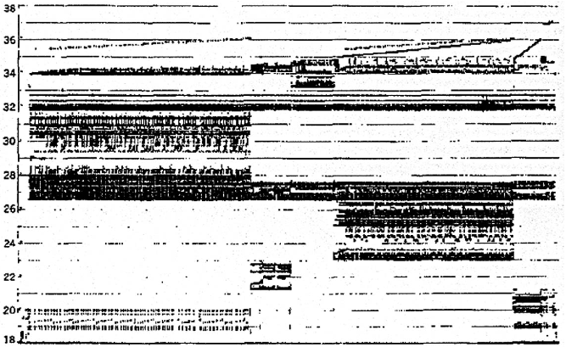
Memory Reference Patterns
Temporal
Locality
Memory Address (one dot per access)
Spatial
Locality
Donald J. Hatfield, Jeanette Gerald: Program Restructuring for Virtual Memory. IBM Systems Journal 10(3): 168-192 (1971)
Time
5/14/2025

Slide 13
Memory Reference Patterns
Address
n loop iterations
Instruction
fetches
subroutine call
subroutine return
Stack
accesses
argument access
vector access
Data
accesses
scalar accesses
Time
5/14/2025
13

Slide 14
Outline
Cache Introduction
Cache Organization
Cache Performance Analysis

Slide 15
Processor with Cache
Processor
Memory
Enable?
Read/Write
Input
Control
Program
Cache
Datapath
Memory (including
cache) organized around blocks, which are typically multiple words
Address
Bytes
PC
Write Data
Registers
Data
Arithmetic & Logic Unit
(ALU)
ReadData
Output
Processor organized around words and bytes
Processor-Memory Interface
I/O-Memory Interfaces
15

Slide 16
Cache vs. Memory
Cache size << memory size
Smaller cache is faster
1-to-many correspondence between cache blocks and memory blocks
Use Tags in the cache to match cache and memory blocks
A cache block is also called a cache line
Blocks are aligned in memory:
if each cache block is 4 Bytes (1 word), then binary address of each cache block always ends in 00
If each cache block is 8 Bytes (2 words), then binary address each cache block always ends in 000
16
Notes:
If each cache block is 4 Bytes (1 word), then binary address each cache block always ends in 00_{two}
How to take advantage of this to save hardware and energy?
Don’t need to compare last 2 bits of 32-bit byte address (comparator can be narrower)
Don’t need to store last 2 bits of 32-bit byte address in Cache Tag (Tag can be narrower)
If each cache block is 8 Bytes (2 words), then binary address each cache block always ends in 000_{two}

Slide 17
Cache Blocks
CPU
Smaller, faster, more expensive memory
Typical block size: 1 – 4 words (4 – 16 Bytes)
Cache
7
9
14
3
14
Memory
0
1
2
3
Larger, slower, cheaper memory.
4
5
6
7
8
9
10
11
12
13
14
15

Slide 18
General Cache Concepts: Hit
CPU
Data in block 14 is needed
Request: 14
Block 14 is in cache:
Hit!
Cache
7
9
14
3
14
Data is loaded from cache into CPU register
Memory
0
1
2
3
4
5
6
7
8
9
10
11
12
13
14
15

Slide 19
General Cache Concepts: Miss
CPU
Data in block 12 is needed
Request: 12
Block 12 is not in cache:
Miss!
Cache
7
9
14
3
12
Block 12 is fetched from
memory
12
Request: 12
Block 12 is stored in cache
Placement policy: determines where the new block goes
Replacement policy: determines which old block gets evicted (victim)
Memory
0
1
2
3
4
5
6
7
8
9
10
11
12
12
13
14
15
Data is loaded from cache into CPU register

Slide 20
Inside a Cache
A “valid bit” indicates of a cache block contains valid data
e.g., upon startup, the cache is “cold”: all cache blocks are invalid
The cache is “warmed-up” gradually by bringing content into the cache
A tag helps identify the memory block contained in the cache block
Disambiguate among multiple possible memory blocks that may be mapped to the same cache block
Cache capacity refers to the total size of cache blocks (not including Tag and Valid bits)
Address
Address
Processor
CACHE
Main
Memory
Data
Data
Valid
Tag
0
100
Data
Byte
Data
Byte
Data
Byte
Data
Byte
A Cache Block
1
304
0
6848
1
416
1
1
Notes:
Tag only needs enough bits to uniquely identify the block (jse)

Slide 21
Memory Address Fields
Offset: Byte address within a cache block
Set Index: Selects which set
Tag: Remaining portion of processor address
Size of Set Index (SI) = log₂(number of sets)
Size of Offset = log₂(number of bytes/block)
Size of Tag = Address size – Size of SI - Size of Offset
Memory Address
Tag
Set Index
Offset
5/14/2025
Notes:
For class handout

Slide 22
Cache Organization
Compare Tag to select a way
# ways (associativity)
Tag | Set Index | Offset
Use Offset to find Byte address within cache block
Use Set Index to select a set
# sets
(Set Index increases from top to bottom)
SI identifies a set; Tag identifies the block within the set; Offset identifies the byte within the block (if cache hit).
Tag
Data
#blocks = #ways * #sets
(Valid bit omitted)
22

Slide 23
Sources of Cache Misses (3 C’s)
Compulsory: cold start, first access to a block
Unavoidable misses that would occur even with infinite cache
Can be reduced by increasing block size
Capacity: cache is too small to hold all data needed by the program
Misses that would occur even under perfect replacement policy
Can be reduced by increasing cache capacity
Conflict: collisions due to multiple memory addresses mapped to same cache set
Can be reduced by increasing associativity and/or increasing cache capacity
Notes:
Recall the ping-pong cache example
Compulsory misses are cache misses due to cold start. You cannot avoid them but if you are going to run billions of instructions anyway, compulsory misses usually don’t bother you.
Conflict misses are misses caused by multiple memory location being mapped to the same cache location.
The nightmare scenario is the ping pong effect when a block is read into the cache but before we have a chance to use it, it was immediately forced out by another conflict miss.
You can reduce Conflict misses by either increase the cache size or increase the associativity, or both.
Finally, Capacity misses occurs when the cache is not big enough to contains all the cache blocks required by the program. You can reduce this miss rate by making the cache larger.
(Capacity miss) That is the cache misses are due to the fact that the cache is simply not large enough to contain all the blocks that are accessed by the program.
The solution to reduce the Capacity miss rate is simple: increase the cache size.
Here is a Summary of other types of cache miss we talked about.
First is the Compulsory misses. These are the misses that we cannot avoid. They are caused when we first start the program.
Then we talked about the conflict misses. They are the misses that caused by multiple memory locations being mapped to the same cache location.
There are two solutions to reduce conflict misses. The first one is, once again, increase the cache size. The second one is to increase the associativity.
For example, say using a 2-way set associative cache instead of directed mapped cache.
But keep in mind that cache miss rate is only one part of the equation. You also have to worry about cache access time and miss penalty. Do NOT optimize miss rate alone.
Finally, there is another source of cache miss we will not cover today. Those are referred to as invalidation misses caused by another process, such as IO , update the main memory so you have to flush the cache to avoid inconsistency between memory and cache.
+2 = 43 min. (Y:23)

Slide 24
Alternative Cache Organizations
A memory block is mapped to one cache set, which may contain one or more cache blocks
Direct Mapped (DM)
Each cache set has 1 cache block; # cache sets = # cache blocks
A memory block is mapped to 1 possible cache block
N-way Set Associative (SA)
Associativity = N → Each cache set has N cache blocks; # cache sets = # cache blocks/N
A memory block can be mapped to one of N possible cache blocks
Fully Associative (FA)
A single cache set contains all cache blocks; # cache sets = 1
A memory block can be mapped to any cache block
DM and FA are special cases of SA
DM = 1-way SA (N = 1)
FA = N-way SA (N = cache capacity (total # cache blocks))

Slide 25
Alternative Cache Organizations (4-block cache)
Block Number
1 1 1 1 1 1 1 1 1 1 0 1 2 3 4 5 6 7 8 9
2 2 2 2 2 2 2 2 2 2 0 1 2 3 4 5 6 7 8 9
3 3
0 1
0 1 2 3 4 5 6 7 8 9
Memory
(32 blocks)
Where are possible locations in cache that block #12 in memory can be placed?
Set Number
Cache
(4 blocks)
0 1 2 3
0 1 0 1
0
DM 2-way SA FA (4-way SA)
In set 0 In set 0 In set 0
(1 block) (2 blocks) (4 blocks)
25
Notes:
Simplest scheme is to extract bits from ‘block number’ to determine ‘set’ (jse)
More sophisticated schemes will hash the block number ---- why could that be good/bad?
(12 mod 4=0) (12 mod 2=0)

Slide 26
Range of SA Cache Organizations
memory_address_size = tag_size (T) + set_index_size (SI) + block_offset_size (O)
For fixed cache size, increasing associativity decreases number of sets while increasing number of blocks per set.
If we decrease index by 1 bit and increase tag by 1 bit (pushing the red bar to the right by 1 bit) :
Doubled: #ways = #blocks per cache set = associativity
Halved: #cache sets
Used for tag compare
Selects the set
Selects the Byte in the block
Tag
Set Index
Offset
Increasing associativity, higher way, less sets
Decreasing associativity, lower way, more sets
Fully Associative (one set)
Tag + Offset, no Set Index
Direct Mapped
(only one way)
Smaller tag
Way
Set
Valid
Tag
Data
Way
Set
Valid
Tag
Data
Way
Set
Valid
Tag
Data
0
0
01
0
0
010
0
0
0101
1
1
11
0
1
1
111
1
1
1110
0
0
2
1
10
1
0
1
101
2
1
1010
3
1
00
1
1
001
3
1
0011
Direct Mapped
2-Way Set Associative
Fully Associative
5
4
3
2
1
0
5
4
3
2
1
0
5
4
3
2
1
0
Tag | Set Index | Offset
Tag | Index | Offset
Tag | Offset
Notes:
each increase by a factor of two in associativity doubles the number of blocks per set (i.e., the number of “ways”) and halves the number of sets
, only a single comparator
, and a given block size

Slide 27
4-Block Cache (Valid Bit Omitted)
Higher associativity → More ways → fewer cache sets → cache structure is more “short (vertically) and fat (horizontally)”
Lower associativity → Fewer ways → more cache sets → cache structure is more “tall (vertically) and skinny (horizontally)”
Direct-Mapped
2-way Set Associative
Way
Set
Tag
Data
Way
Set
Tag
Data
Set
Tag
Data
Tag
Data
0
0
Redraw
0
1
0
1
1
0
2
1
0
Way 0
Way 1
3
1
5
4
3
2
1
0
5
3
2
1
0
Tag
Set Index
Offset
Tag
Set Index
Offset
# cache blocks = 1 way * 4 sets = 4
# cache blocks = 2 ways * 2 sets = 4
Fully Associative (4-way Set Associative)
Way
Set
Tag
Data
Redraw
0
0101
1
1110
Tag
Data
Tag
Data
Tag
Data
Tag
Data
0
Set 0
2
1010
0011
Way 0
Way 1
Way 2
Way 3
3
5
2
1
0
Tag
Offset
# cache blocks= 4 ways * 1 set = 4
27
Notes:
Total size of $ in blocks is equal to number of sets x associativity. For fixed $ size, increasing associativity decreases number of sets while increasing number of elements per set. With eight blocks, an 8-way set-associative $ is same as a fully associative $.

Slide 28
Bookshelf Analogy
Tag
Index
Offset
Book
Book
Book
Book
Direct Mapped (associativity=1): Each cache set contains one block. A cache block can only go in one position in the cache. It makes a cache block easy to find, but it's not inflexible about where to put it.
Tag
Index
Offset
Book
Book
Book
Book
Set Associative w/ low associativity: Each cache set contains 2 blocks. The index is used to find the set, and the tag is used to find the block within the set in case of cache hit.
Book
Book
Book
Book
Tag
Index
Offset
Set Associative w/ high associativity: Each cache set contains 4 blocks, so there are fewer sets. As such, fewer index bits are needed.
Tag
Offset
Book
Book
Book
Book
Fully Associative: No index is needed, since a cache block can go anywhere in the cache. Every tag must be compared when finding a block in the cache, but block placement is very flexible.
Notes:
Illustration from http://csillustrated.berkeley.edu/PDFs/cache-types.pdf

Slide 29
Bookshelf Analogy
Direct-Mapped
Way
Set
Tag
Data
Book
Book
Book
Book
0
0
1
2
3
Book
Book
Book
Book
2-way Set Associative
Set
Tag
Data
Tag
Data
0
Book
1
Book
Book
Book
Way 0
Way 1
Fully Associative (4-way Set Associative)
Book
Book
Book
Book
Tag
Data
Tag
Data
Tag
Data
Tag
Data
Set 0
Way 0
Way 1
Way 2
Way 3
Notes:
Illustration from http://csillustrated.berkeley.edu/PDFs/cache-types.pdf

Slide 30
Associativity and Performance
Increasing associativity:
increases hit time because there are more cache blocks per set (books per partition) to compare the tags with to find a match
reduces miss rate by reducing conflict misses, since block placement within each set (book placement within each partition) becomes more flexible
Decreasing associativity
reduces hit time because there are fewer blocks per set (books per partition) to compare the tags with to find a match
increases miss rate by increasing conflict misses, since block placement within each set (book placement within each partition) becomes less flexible (may cause Ping-Pong effect)

Slide 31
Direct-Mapped Cache
Q: Given a memory block, which cache block is it mapped to?
A: Use 2 middle index bits in memory address to determine which cache block it is mapped to
00: mapped to blue block in cache
01: mapped to green block in cache
10: mapped to pink block in cache
11: mapped to grey block in cache
Main Memory
0000xx
0001xx
0010xx
0011xx
0100xx
0101xx
0110xx
0111xx
1000xx
1001xx
1010xx
1011xx
1100xx
1101xx
1110xx
1111xx
Cache
Way
Set
Valid
Tag
Data
00
01
0
10
11
Q: Is the memory block in the cache?
A: Compare 2 higher tag bits in memory address to the cache tag to tell if the memory block is in the cache (provided valid bit is set)
6-bit memory address: 2-bit Tag, 2-bit Set Index, 2-bit Offset (4 Bytes/block).
5
4
3
2
1
0
Q: Which exact Byte address in the given cache block of 4 Bytes?
A: Use the Offset
Tag | Set Index | Offset
Notes:
Q: Which exact Byte address in a given cache block of 4 Bytes?
A: Use the Offset
Valid bit indicates whether an entry contains valid information – if the bit is not set, there cannot be a match for this block One word blocks
Two low order bits (xx) define the byte in the block (1 word = 4 Byes) (i.e., modulo the number of blocks in the cache)

Slide 32
DM Cache Example
Q: Given memory address 001110, is it in the cache?
Main Memory
0000xx
0001xx
0010xx
0011xx
0100xx
0101xx
0110xx
0111xx
1000xx
1001xx
1010xx
1011xx
1100xx
1101xx
1110xx
1111xx
Cache
Way
Set
Valid
Tag
Data
0
0
01
1
1
11
Q: Given memory address 0100xx, is it in the cache?
0
2
1
10
3
1
00
6-bit memory address: 2-bit Tag, 2-bit Set Index, 2-bit Offset (4 Bytes/block).
Q: Given memory address 1110xx, is it in the cache?
5
4
3
2
1
0
Tag | Set Index | Offset
Notes:
For lecture
Valid bit indicates whether an entry contains valid information – if the bit is not set, there cannot be a match for this block One word blocks
Two low order bits (xx) define the byte in the block (1 word = 4 Byes)

Slide 33
Q: Given memory address 001110, is it in the cache?
A: Yes. First, 2 middle index bits (11) means that it is mapped to a grey block in cache; Second, the 2 higher tag bits (00) matches the tag in the grey block, with valid bit of 1; Finally, to get the exact Byte address, use the Offset of 10
DM Cache Example
Main Memory
0000xx
0001xx
0010xx
0011xx
0100xx
0101xx
0110xx
0111xx
1000xx
1001xx
1010xx
1011xx
1100xx
1101xx
1110xx
1111xx
Cache
Way
Set
Valid
Tag
Data
00
0
01
Q: Given memory address 0100xx, is it in the cache?
A: No. First, 2 middle bits (00) means that it is mapped to a blue block in cache; Second, the 2 higher tag bits (01) matches the tag in the blue block, with valid bit of 0, so cache block is invalid.
01
1
11
0
10
1
10
11
1
00
6-bit memory address: 2-bit Tag, 2-bit Set Index, 2-bit Offset (4 Bytes/block).
Q: Given memory address 1110xx, is it in the cache?
A: No. First, 2 middle index bits (10) means that it is mapped to a pink block in cache, with valid bit of 1; Second, the 2 higher tag bits (11) does not match the tag (10) in the pink block.
5
4
3
2
1
0
Tag | Set Index | Offset
Notes:
For lecture
Valid bit indicates whether an entry contains valid information – if the bit is not set, there cannot be a match for this block One word blocks
Two low order bits (xx) define the byte in the block (1 word = 4 Byes)

Slide 34
DM Cache w/ Ping Pong Effect
Main Memory
0000xx
0001xx
0010xx
0011xx
0100xx
0101xx
0110xx
0111xx
1000xx
1001xx
1010xx
1011xx
1100xx
1101xx
1110xx
1111xx
Consider the sequence of memory block addresses (0 and 4) referenced at runtime (Offset omitted):
0000xx (0), 0100xx (4), 0000xx, 0100xx, 0000xx, 0100xx, 0000xx, 0100xx
They all map to Set 0, which contains 1 cache block
Cache
Way
Set
Valid
Tag
Data
0
1
01
00
1
0
2
3

Slide 35
DM Cache w/ Ping Pong Effect
Consider the sequence of memory addresses referenced at runtime: 0000xx, 0100xx, 0000xx, 0100xx, 0000xx, 0100xx, 0000xx, 0100xx. All mapped to Set 0.
Start with an empty cache - all blocks initially marked as not valid
0000xx
miss
01
0100xx
miss
00
0000xx
miss
01
0100xx
miss
4
4
0
00 Mem(0)
00 Mem(0)
01 Mem(4)
00 Mem(0)
00
0000xx
miss
0
01
0100xx
miss
4
00
0000xx
miss
0
01
0100xx
miss
4
01 Mem(4)
00 Mem(0)
01 Mem(4)
00 Mem(0)
8 requests, 8 misses
Ping-pong effect due to conflict misses - two memory addresses that map into the same cache block
Notes:
For class handout

Slide 36
2-Way Set-Associative Cache
Q: Given a memory block, which cache set is it mapped to?
A: Use 1 middle index bits in memory address to determine which cache set it is mapped to
0: mapped to blue set in cache
1: mapped to pink set in cache
Main Memory
0000xx
0001xx
0010xx
0011xx
0100xx
0101xx
0110xx
0111xx
1000xx
1001xx
1010xx
1011xx
1100xx
1101xx
1110xx
1111xx
Cache
Way
Set
Valid
Tag
Data
0
0
1
0
Q: Is the memory block in the cache?
A: Compare 3 higher tag bits in memory address to the cache tag to tell if the memory block is in the cache (provided valid bit is set)
1
1
6-bit memory address: 3-bit Tag, 1-bit Set Index, 2-bit Offset (each cache block is 4 Bytes/1 Word).
5
4
3
2
1
0
Tag | Index | Offset
Notes:
For lecture
Valid bit indicates whether an entry contains valid information – if the bit is not set, there cannot be a match for this block One word blocks
Two low order bits (xx) define the byte in the block (1 word = 4 Byes) (i.e., modulo the number of blocks in the cache)

Slide 37
2-Way SA Cache Example
Q: Given memory address 0111xx, is it in the cache?
Main Memory
0000xx
0001xx
0010xx
0011xx
0100xx
0101xx
0110xx
0111xx
1000xx
1001xx
1010xx
1011xx
1100xx
1101xx
1110xx
1111xx
Cache
Way
Set
Valid
Tag
Data
0
0
010
0
1
1
111
Q: Given memory address 0100xx, is it in the cache?
1
0
1
101
1
1
001
6-bit memory address: 3-bit Tag, 1-bit Set Index, 2-bit Offset (each cache block is 4 Bytes/1 Word).
Q: Given memory address 1110xx, is it in the cache?
5
4
3
2
1
0
Tag | Index | Offset
Notes:
For lecture
Valid bit indicates whether an entry contains valid information – if the bit is not set, there cannot be a match for this block One word blocks
Two low order bits (xx) define the byte in the block (1 word = 4 Byes) (i.e., modulo the number of blocks in the cache)

Slide 38
2-Way SA Cache Example
Q: Given memory address 0111xx, is it in the cache?
A: No. First, 1 middle index bit (1) means that it is mapped to pink set in cache; Second, the 3 higher tag bits (011) does not match any tag in the pink set (101 and 001).
Main Memory
0000xx
0001xx
0010xx
0011xx
0100xx
0101xx
0110xx
0111xx
1000xx
1001xx
1010xx
1011xx
1100xx
1101xx
1110xx
1111xx
Cache
Q: Given memory address 0100xx, is it in the cache?
A: No. First, 1 middle index bit (0) means that it is mapped to blue set in cache; Second, the 3 higher tag bits (010) matches one of the tags in the blue set (010 and 111); Third, the valid bit of the corresponding cache block is 0.
Way
Set
Valid
Tag
Data
0
0
010
0
1
1
101
1
0
1
111
1
1
001
6-bit memory address: 3-bit Tag, 1-bit Set Index, 2-bit Offset (each cache block is 4 Bytes/1 Word).
Q: Given memory address 1110xx, is it in the cache?
A: Yes. First, 1 middle index bit (0) means that it is mapped to blue set in cache; Second, the 3 higher tag bits (111) matches one of the tags in the blue set (010 and 111); Third, the valid bit is 1.
5
4
3
2
1
0
Tag | Index | Offset
38
Notes:
For lecture
Valid bit indicates whether an entry contains valid information – if the bit is not set, there cannot be a match for this block One word blocks
Two low order bits (xx) define the byte in the block (1 word = 4 Byes) (i.e., modulo the number of blocks in the cache)

Slide 39
2-Way SA Cache w/o Ping Pong Effect
Main Memory
0000xx
0001xx
0010xx
0011xx
0100xx
0101xx
0110xx
0111xx
1000xx
1001xx
1010xx
1011xx
1100xx
1101xx
1110xx
1111xx
Consider the sequence of memory block addresses (0 and 4) referenced at runtime (Offset omitted):
0000xx (0), 0100xx (4), 0000xx, 0100xx, 0000xx, 0100xx, 0000xx, 0100xx
They all map to Set 0, which contains 2 cache blocks. This avoids Ping Pong effect
Cache
Way
Set
Valid
Tag
Data
0
1
000
0
1
1
0
1
010
1

Slide 40
2-Way SA Cache w/o Ping Pong Effect
Consider the sequence of memory addresses referenced at runtime: 0000xx, 0100xx, 0000xx, 0100xx, 0000xx, 0100xx, 0000xx, 0100xx. All mapped to Set 0.
Start with an empty cache - all blocks initially marked as not valid
0000xx
miss
0100xx
miss
0000xx
hit
0100xx
hit
000 Mem(0)
000 Mem(0)
000 Mem(0)
000 Mem(0)
010 Mem(4)
010 Mem(4)
010 Mem(4)
…
…
8 requests, 2 misses
Two memory addresses that map into the same cache set can co-exist in the 2-way SA cache, removes the Ping-Pong effect of DM cache
5/14/2025
Notes:
For lecture
Another sample string to try 0 1 2 3 0 8 11 0 3

Slide 41
Fully-Associative Cache (4-way SA)
Each memory block is mapped to anywhere in the cache set
Main Memory
0000xx
0001xx
0010xx
0011xx
0100xx
0101xx
0110xx
0111xx
1000xx
1001xx
1010xx
1011xx
1100xx
1101xx
1110xx
1111xx
Cache
Q: Given a memory block, which cache set is it mapped to?
A: There is only a single blue set.
Way
Set
Valid
Tag
Data
0
1
0
2
Q: Is the exact memory block in the cache?
A: Compare 4 higher tag bits in memory address to the cache tag to tell if the memory block is in the cache (provided valid bit is set)
Q: Which exact Byte address in a given cache block of 4 Bytes?
A: Use the Offset
3
6-bit memory address: 4-bit Tag, 0-bit Set Index, 2-bit Offset (each cache block is 4 Bytes/1 Word).
5
4
3
2
1
0
Tag | Offset
Notes:
For lecture
Valid bit indicates whether an entry contains valid information – if the bit is not set, there cannot be a match for this block One word blocks
Two low order bits (xx) define the byte in the block (1 word = 4 Byes) (i.e., modulo the number of blocks in the cache)

Slide 42
FA Cache Example
Q: Given memory address 0011xx, is it in the cache?
Main Memory
0000xx
0001xx
0010xx
0011xx
0100xx
0101xx
0110xx
0111xx
1000xx
1001xx
1010xx
1011xx
1100xx
1101xx
1110xx
1111xx
Cache
Way
Set
Valid
Tag
Data
0
0
0101
Q: Given memory address 0100xx, is it in the cache?
1
1
1110
0
2
1
1010
3
1
0011
6-bit memory address: 3-bit Tag, 1-bit Set Index, 2-bit Offset (each cache block is 4 Bytes/1 Word).
Q: Given memory address 0101xx, is it in the cache?
5
4
3
2
1
0
Tag | Offset
Notes:
For lecture
Valid bit indicates whether an entry contains valid information – if the bit is not set, there cannot be a match for this block One word blocks
Two low order bits (xx) define the byte in the block (1 word = 4 Byes) (i.e., modulo the number of blocks in the cache)

Slide 43
FA Cache Example
Q: Given memory address 0011xx, is it in the cache?
A: Yes. The 4 higher tag bits (0011) matches one of the tags in the cache (the blue set), and the valid bit of the corresponding cache block is 1.
Main Memory
0000xx
0001xx
0010xx
0011xx
0100xx
0101xx
0110xx
0111xx
1000xx
1001xx
1010xx
1011xx
1100xx
1101xx
1110xx
1111xx
Cache
Way
Set
Valid
Tag
Data
0
0
0101
Q: Given memory address 0100xx, is it in the cache?
A: No. The 4 higher tag bits (0100) does not match any of the tags in the cache.
1
1
1110
0
2
1
1010
3
1
0011
6-bit memory address: 4-bit Tag, 0-bit Set Index, 2-bit Offset (each cache block is 4 Bytes/1 Word).
Q: Given memory address 0101xx, is it in the cache?
A: No. The 4 higher tag bits (0101) matches one of the tags in the blue set, but the valid bit of the corresponding cache block is 0.
5
4
3
2
1
0
Tag | Offset
Notes:
For lecture
Valid bit indicates whether an entry contains valid information – if the bit is not set, there cannot be a match for this block One word blocks
Two low order bits (xx) define the byte in the block (1 word = 4 Byes) (i.e., modulo the number of blocks in the cache)

Slide 44
FA Cache w/o Ping Pong Effect
Main Memory
0000xx
0001xx
0010xx
0011xx
0100xx
0101xx
0110xx
0111xx
1000xx
1001xx
1010xx
1011xx
1100xx
1101xx
1110xx
1111xx
Consider the sequence of memory block addresses (0 and 4) referenced at runtime (Offset omitted):
0000xx (0), 0100xx (4), 0000xx, 0100xx, 0000xx, 0100xx, 0000xx, 0100xx
They all map to Set 0, which contains 4 cache blocks. This avoids Ping Pong effect
Cache
Way
Set
Valid
Tag
Data
0
1
0000
1
0
1
0100
2
3

Slide 45
FA Cache w/o Ping Pong Effect
Consider the sequence of memory addresses referenced at runtime: 0000xx, 0100xx, 0000xx, 0100xx, 0000xx, 0100xx, 0000xx, 0100xx. All mapped to Set 0.
Start with an empty cache - all blocks initially marked as not valid
0000xx
miss
0100xx
miss
0000xx
hit
0100xx
hit
000 Mem(0)
000 Mem(0)
000 Mem(0)
000 Mem(0)
010 Mem(1)
010 Mem(1)
010 Mem(1)
…
…
8 requests, 2 misses
Two memory addresses that map into the same cache set can co-exist in the FA cache, removes the Ping-Pong effect of DM cache
5/14/2025
Notes:
For lecture
Another sample string to try 0 1 2 3 0 8 11 0 3

Slide 46
Example: Calculate Number of Cache Misses
Consider the following program that repeatedly accesses an array A of four words (4 bytes each):
for (int i=0; i++, i<10000) {sum += A[0]+A[1]+A[2]+A[3];}
Suppose A[0] starts at memory address 000000, then A[0], A[1], A[2], A[3] start at memory addresses 000000, 000100, 001000, 001100, respectively, and this sequence of memory addresses are visited repeatedly in a cyclic manner.
1) How many cache misses occur due to reading array A[] for a DM cache?
2) Answer the same questions for a two-way SA cache.
3) Answer the same questions for a FA cache.
Notes:
4 cache misses:
Consider the following (silly) program that repeatedly accesses an array of 4-Byte ints A[4]
for (int i=0; i++, i<10000) {sum += A[0]+A[1]+A[2]+A[3];}
Suppose A[0] starts at memory address 000000, how many cache misses due to reading array A[] for a DM cache with either 1) the Tag-Set Index-Offset model; or 2) the Set Index-Tag-Offset model? (Assuming that LDR is used to load elements of A[] in every iteration, instead of keeping them in CPU registers.)

Slide 47
Example: DM Cache
Main Memory
DM cache: 4 misses
1st cache miss brings a block with address 0000xx into cache Set 0, which contains A[0]
2nd cache miss brings a block with address 0001xx into cache Set 1, which contains A[1]
3rd cache miss brings a block with address 0010xx into cache Set 2, which contains A[2]
4th cache miss brings a block with address 0011xx into cache Set 3, which contains A[3]
All subsequent cache accesses are cache hits
After 10000 iterations, 4 cache misses, 9996 cache hits.
A[0]
0000xx
0001xx
0010xx
0011xx
0100xx
0101xx
0110xx
0111xx
1000xx
1001xx
1010xx
1011xx
1100xx
1101xx
1110xx
1111xx
Cache
A[1]
A[2]
Way
Set
Valid
Tag
Data
A[3]
00
1
00
A[0]
01
1
00
A[1]
0
10
1
00
A[2]
11
1
00
A[3]
5
4
3
2
1
0
Tag | Set Index | Offset

Slide 48
Example: 2-Way SA Cache
Main Memory
2-Way SA Cache: 4 misses
1st cache miss brings into cache a block with address 0000xx into Set 0, which contains A[0]
2nd cache miss brings into cache a block with address 0001xx into Set 1, which contains A[1]
3rd cache miss brings into cache a block with address 0010xx into Set 0, which contains A[2]
4th cache miss brings into cache a block with address 0011xx into Set 1, which contains A[3]
All subsequent cache accesses are cache hits
After 10000 iterations, 4 cache misses, 9996 cache hits
A[0]
0000xx
0001xx
0010xx
0011xx
0100xx
0101xx
0110xx
0111xx
1000xx
1001xx
1010xx
1011xx
1100xx
1101xx
1110xx
1111xx
Cache
A[1]
A[2]
Way
Set
Valid
Tag
Data
A[3]
0
1
000
A[0]
0
1
1
000
A[1]
1
0
1
001
A[2]
1
1
001
A[3]
5
4
3
2
1
0
Tag | Index | Offset

Slide 49
Example: FA Cache
Main Memory
A[0]
0000xx
0001xx
0010xx
0011xx
0100xx
0101xx
0110xx
0111xx
1000xx
1001xx
1010xx
1011xx
1100xx
1101xx
1110xx
1111xx
FA cache: 4 misses with LRU (Least-Recently-Used) replacement policy
1st cache miss brings into cache a block with address 0000xx into Set 0, which contains A[0]
2nd cache miss brings into cache a block with address 0001xx into Set 0, which contains A[1]
3rd cache miss brings into cache a block with address 0010xx into Set 0, which contains A[2]
4th cache miss brings into cache a block with address 0011xx into Set 0, which contains A[3]
All subsequent cache accesses are cache hits
After 10000 iterations, 4 cache misses, 9996 cache hits.
Cache
A[1]
A[2]
Way
Set
Valid
Tag
Data
A[3]
0
1
0000
A[0]
1
1
0001
A[1]
0
2
1
0010
A[2]
3
1
0011
A[3]
5
4
3
2
1
0
Tag | Offset
Notes:
4 cache misses:

Slide 50
Tradeoffs of Cache Block Sizes
Smaller cache blocks → more fine-grained caching → take better advantage of temporal locality
A given data item stays in the cache longer before getting replaced
Larger cache blocks → more coarse-grained caching, take better advantage of spatial locality
Fetching each cache block brings in lots of data at nearby addresses into the cache

Slide 51
DM Cache: Memory Access Example
Consider 6-bit memory address with Tag 2b; Index 2b; Offset 2b (We ignore Byte offset bits, and only consider 4-bit word addresses: Tag 2b; Index 2b)
Start with an empty cache - all blocks initially marked as not valid. Fill in the cache state table below for the sequence of memory address accesses:
0 1 2 3 4 3 4 15
0000 0001 0010 0011 0100 0011 0100 1111
0
miss
1
miss
2
miss
3
miss
00 Mem(0)
00 Mem(0)
00 Mem(0)
00 Mem(1)
00 Mem(0)
00 Mem(1)
00 Mem(2)
00 Mem(1)
00 Mem(2)
00 Mem(3)
Time
4
miss
3
hit
4
hit
15
miss
01
(4)
00 Mem(0)
00 Mem(1)
00 Mem(2)
00 Mem(3)
01 Mem(4)
00 Mem(1)
00 Mem(2)
00 Mem(3)
01 Mem(4)
00 Mem(1)
00 Mem(2)
00 Mem(3)
01 Mem(4)
00 Mem(1)
00 Mem(2)
00 Mem(3)
11
(15)
Time
5
4
3
2
1
0
8 requests, 6 misses
Tag | Set Index | Offset
51
Notes:
For lecture
Reference string is word addresses (or block number since we are using one word blocks) – i.e., the low order two bits used to selected the byte in the 32-bit word are ignored

Slide 52
DM cache: larger block size helps take advantage of spatial locality
Each cache block holds 2 words; so Tag 2b; Index 1b; Offset 3b for Byte address (we use Offset 1b to refer to 1 of 2 words in block, not Bytes.)
0 1 2 3 4 3 4 15
Start with an empty cache - all blocks initially marked as not valid
0000 0001 0010 0011 0100 0011 0100 1111
0
miss
1
hit
2
miss
00 Mem(1) Mem(0)
00 Mem(1) Mem(0)
00 Mem(1) Mem(0)
00 Mem(3) Mem(2)
3
hit
4
miss
3
hit
01
(5)
(4)
00 Mem(1) Mem(0)
00 Mem(1) Mem(0)
01 Mem(5) Mem(4)
00 Mem(3) Mem(2)
00 Mem(3) Mem(2)
00 Mem(3) Mem(2)
4
hit
15
miss
01 Mem(5) Mem(4)
01 Mem(5) Mem(4)
11
00 Mem(3) Mem(2)
00 Mem(3) Mem(2)
(15)
5
(14)
4
3
2
1
0
8 requests, 4 misses
Tag | Index | Offset
52
Notes:
to take advantage for spatial locality want a cache block that is larger than word word in size.
Show the 4-bit address mapping – 2-bits of tag, 1-bit of set address (index), 1-bit of word-in-block select

Slide 53
Associativity in the Memory Hierarchy
On-Chip Components
CPU Control
Instr
Cache
Second
Level
Cache
(SRAM)
Secondary
Memory
(Disk
Or Flash)
Main
Memory
(DRAM)
CPU
Datapath
RegFile
Data
Cache
Speed (cycles): ½’s 1’s 10’s 100’s 1,000,000’s
Size (bytes): 100B’s 10KB’s MB’s GB’s TB’s
Cost/bit: highest lowest
The closer to the CPU (e.g., L1/L2 cache), the lower associativity (e.g., Direct Mapped), to minimize hit time, since CPU needs to access cache contents fast
The farther away from the CPU (e.g., Last-Level Cache), the higher associativity (e.g., Fully-Associative), to minimize miss rate, since cache misses will go to main memory, which is very slow
Main memory can be viewed a “cache” for disk or Flash, and it is a Fully-Associative cache
Notes:
Instead, the memory system of a modern computer consists of a series of black boxes ranging from the fastest to the slowest.
Besides variation in speed, these boxes also varies in size (smallest to biggest) and cost.
What makes this kind of arrangement work is one of the most important principle in computer design. The principle of locality. The principle of locality states that programs access a relatively small portion of the address space at any instant of time.
The design goal is to present the user with as much memory as is available in the cheapest technology (points to the disk).
While by taking advantage of the principle of locality, we like to provide the user an average access speed that is very close to the speed that is offered by the fastest technology.
(We will go over this slide in detail in the next lectures on caches).
Programmer-invisible hardware mechanism gives illusion of speed of fastest memory with size of largest memory
Works even if you have no idea what a cache is
Performance-oriented programmers sometimes “reverse engineer” cache organization to design data structures and access patterns optimized for a specific cache design

Slide 54
Summary of Cache Organizations
A memory block is mapped to one cache set, which may contain one or more cache blocks
Direct Mapped (DM)
Each cache set has 1 cache block; # cache sets = # cache blocks
A memory block is mapped to 1 possible cache block
Fully Associative (FA)
A single cache set contains all cache blocks; # cache sets = 1
A memory block can be mapped to any cache block
N-way Set Associative (SA)
Each cache set has N cache blocks; # cache sets = # cache blocks / N
N is also called associativity
A memory block can be mapped to one of N possible cache blocks
DM and FA are special cases of SA
DM = 1-way SA (N = 1)
FA = N-way SA (N = total number of cache blocks)
Notes:
A Direct-Mapped cache is equivalent to a 1-way set associative cache
A Fully Associative cache of m blocks is equivalent to an m-way set associative cache
Need to compare every tag in each cache set to the memory address; no need to compare tags in different cache sets
# HW comparators == # cache blocks in each cache set = # ways = associativity
Direct Mapped: a memory block is mapped to one address in cache
# cache sets = # cache blocks; each cache set has 1 cache block
# HW comparators = 1
Fully Associative: a memory block can be mapped to any address in cache
# cache sets = 1; it contains all cache blocks
# HW comparators = # cache blocks, plus a HW mux
N-way Set Associative: a memory block can be mapped to one of N possible addresses in cache
# cache sets = # cache blocks / N; each cache set has N cache blocks
Fully Associative: N = total number of cache blocks
Direct Mapped: N = 1
N HW comparators, plus a HW mux

Slide 55
Key Equations
# sets = 2^{SI size}; # Bytes/block=2^{Offset size}
# blocks = # ways (associativity) * # sets
cache capacity = # blocks * # Bytes/block
Tag size does not affect cache capacity; depends on memory address length
SI size determines # sets = 2^{SI size}
Offset size determines Bytes/block = 2^{Offset size}
Tag
Set Index
Offset
Notes:
Total # cache blocks = Associativity * # sets = #ways (blocks/set) × # sets × Bytes/block C = N × S × B

Slide 56
Cache Example I
5
4
3
2
1
0
Tag
Set Index
Offset
Mem Block Within $Block
Block Within $
Byte Within Block
Assume: DM cache; 6-bit memory address: 2-bit Tag, 2-bit index, 2-bit Offset. Compute cache capacity and memory size.
2-bit Offset => Bytes/block = 4;
# sets = 2^{SI Size} = 4
# cache blocks = # ways * # sets = 1*4 = 4
cache capacity = # cache blocks * bytes/block = 4*4 = 16 bytes
Memory size: 2^6 = 64 bytes, or 2^4 = 16 blocks, 4 bytes/block
# sets = 2^{SI size}; # Bytes/block=2^{Offset size}
# blocks = # ways (associativity) * # sets
cache capacity = # blocks * # Bytes/block
Notes:
16 Memory blocks = 16 words = 64 bytes => 6 bits to address all bytes (Memory and cache blocks always have the same size) 4 Cache blocks, 4 bytes (1 word) per block
4 sets *1 block per set (direct mapped cache) = 4 blocks =
# Memory blocks (16) >> # Cache blocks (4)
4 Memory blocks map to each cache block
Given a memory block, how to determine which cache set it is mapped to?
Look at Set Index: middle two bits
A cache set may contain 1 of 4 possible memory blocks, which exact memory block is mapped to it?
Look at tag: top two bits

Slide 57
Cache Example II
5
4
3
2
1
0
Tag
Set Index
Offset
Mem Block Within $Block
Block Within $
Byte Within Block
Assume: 2-way SA cache; 6-bit memory address: 2-bit Tag, 2-bit index, 2-bit Offset. Compute cache capacity and memory size.
2-bit Offset => Bytes/block = 4;
# sets = 2^{SI Size} = 4
# cache blocks = # ways * # sets = 2*4 = 8
cache capacity = # cache blocks * bytes/block = 8*4 = 32 bytes
Memory size: 2^6 = 64 bytes, or 2^4 = 16 blocks, 4 bytes/block
# sets = 2^{SI size}; # Bytes/block=2^{Offset size}
# blocks = # ways (associativity) * # sets
cache capacity = # blocks * # Bytes/block
Notes:
16 Memory blocks = 16 words = 64 bytes => 6 bits to address all bytes (Memory and cache blocks always have the same size) 4 Cache blocks, 4 bytes (1 word) per block
4 sets *1 block per set (direct mapped cache) = 4 blocks =
# Memory blocks (16) >> # Cache blocks (4)
4 Memory blocks map to each cache block
Given a memory block, how to determine which cache set it is mapped to?
Look at Set Index: middle two bits
A cache set may contain 1 of 4 possible memory blocks, which exact memory block is mapped to it?
Look at tag: top two bits

Slide 58
Cache Example III
5
4
3
2
1
0
Tag
Set Index
Offset
Mem Block Within $Block
Block Within $
Byte Within Block
Assume: 4-way SA cache; 6-bit memory address: 2-bit Tag, 2-bit index, 2-bit Offset. Compute cache capacity and memory size.
2-bit Offset => Bytes/block = 4;
# sets = 2^{SI Size} = 4
# cache blocks = # ways * # sets = 4*4 = 16
cache capacity = # cache blocks * bytes/block = 16*4 = 64 bytes
Memory size: 2^6 = 64 bytes, or 2^4 = 16 blocks, 4 bytes/block
(This is an unlikely case where the memory size is equal to cache size, so the entire memory fits into the cache.)
(We can have at most 4-ways, since 2-bit tag means we can have at most 4 blocks per set, each block with a unique tag.)
# sets = 2^{SI size}; # Bytes/block=2^{Offset size}
# blocks = # ways (associativity) * # sets
cache capacity = # blocks * # Bytes/block
Notes:
16 Memory blocks = 16 words = 64 bytes => 6 bits to address all bytes (Memory and cache blocks always have the same size) 4 Cache blocks, 4 bytes (1 word) per block
4 sets *1 block per set (direct mapped cache) = 4 blocks =
# Memory blocks (16) >> # Cache blocks (4)
4 Memory blocks map to each cache block
Given a memory block, how to determine which cache set it is mapped to?
Look at Set Index: middle two bits
A cache set may contain 1 of 4 possible memory blocks, which exact memory block is mapped to it?
Look at tag: top two bits

Slide 59
Alternative Cache Organizations (8-block cache)
Block Number
1 1 1 1 1 1 1 1 1 1 0 1 2 3 4 5 6 7 8 9
2 2 2 2 2 2 2 2 2 2 0 1 2 3 4 5 6 7 8 9
3 3
0 1
0 1 2 3 4 5 6 7 8 9
Memory
Where are possible locations in cache that block #12 in memory can be placed?
Set Number
Cache
0 1 2 3
4
5
6
7
0 1 2 3
0
1
2
3
0 1 0 1
0
1
0
1
0 1 0 1
0
1
0
1
DM 2-way SA 4-way SA FA(8-way SA)
In set 4 In set 0 In set 0 In set 0
(1 block) (2 blocks) (4 blocks) (8 blocks)
59
Notes:
Simplest scheme is to extract bits from ‘block number’ to determine ‘set’ (jse)
More sophisticated schemes will hash the block number ---- why could that be good/bad?
(12 mod 8=4) (12 mod 4=0) (12 mod 2=0)

Slide 60
8-Block Cache
Each color denotes a cache set
DM:
8 sets
1 way
Set 0
2-Way SA: 4 sets,
2 ways
Set 0
4-Way SA: 2 sets,
4 ways
Set 0
FA: 1 set
1 set,
8 ways
Set 0
Set 0
Set 1
Set 1
Set 1
Set 0
Set 0
Set 2
Set 2
Set 0
Set 0
Set 1
Set 3
Set 3
Set 1
Set 0
Set 4
Set 0
Set 0
Set 0
Set 2
Set 5
Set 1
Set 1
Set 0
Set 1
Set 6
Set 2
Set 0
Set 0
Set 3
Set 7
Set 3
Set 1
Set 0
N-1
5
4
2
1
0
N-1
4
3
2
1
0
N-1
3
2
1
0
N-1
2
1
0
Tag
S.I
O
Tag
S.I
O
Tag
S.I
O
Tag
O
# cache blocks = 1 way * 8 sets =8
# cache blocks = 2 ways * 4 sets =8
# cache blocks = 4 ways * 2 sets =8
# cache blocks = 8 ways * 1 set =8
Notes:
Direct Mapped: 1 way, 8 sets, 8 blocks
2 Way Set Associative: 2 ways, 4 sets, 8 blocks
4 Way Set Associative: 4 ways, 2 sets, 8 blocks
Fully Associative: 8 ways, 1 set, 8 blocks

Slide 61
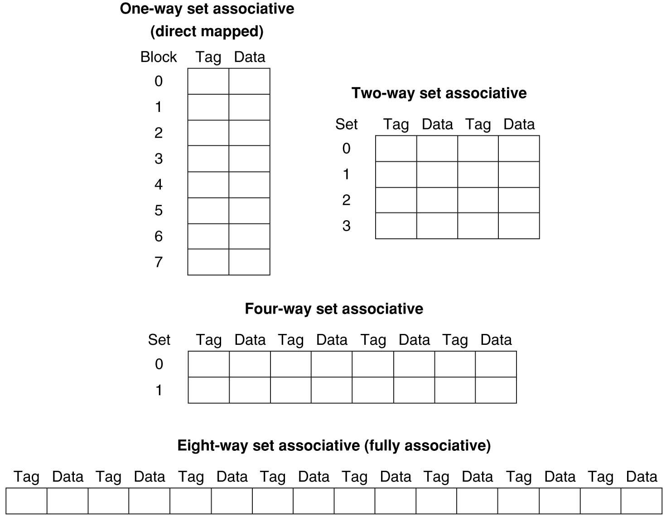
8-Block Cache Summary
Cache: 8 blocks, each 4 Bytes. # cache blocks is equal to number of sets x associativity.
For fixed cache size, increasing associativity decreases number of sets while increasing number of blocks per set.
DM (1-way SA): 8 sets x 1 block per set
2-way SA: 4 sets x 2 blocks per set
4-way SA: 2 sets x 4 blocks per set
FA (4-way SA): 1 set x 8 blocks per set
Higher associativity → More ways → fewer cache sets → cache structure is more “short (vertically) and fat (horizontally)”
Lower associativity → Fewer ways → more cache sets → cache structure is more “tall (vertically) and skinny (horizontally)”
61
Notes:
Total size of $ in blocks is equal to number of sets x associativity. For fixed $ size, increasing associativity decreases number of sets while increasing number of elements per set. With eight blocks, an 8-way set-associative $ is same as a fully associative $.

Slide 62
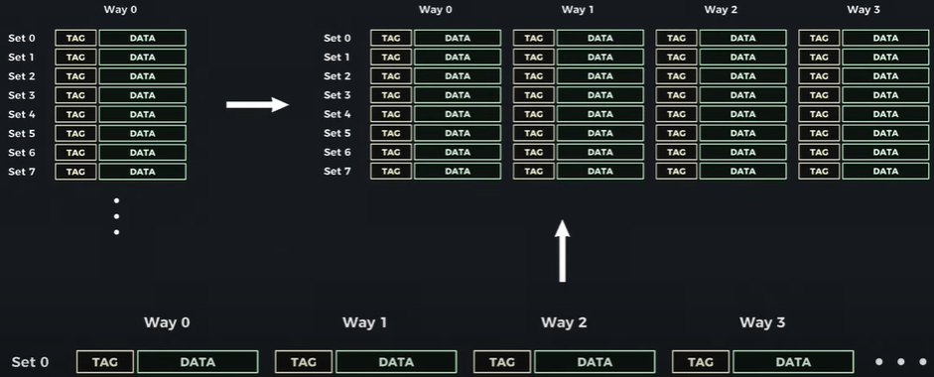
YouTube: How Cache Works Inside a CPU
DM Cache
SA Cache
DM Cache
FA Cache
How Cache Works Inside a CPU
https://www.youtube.com/watch?v=zF4VMombo7U&list=PL38NNHQLqJqYnNrTenxBvGJSPCkV9EOWk&index=1

Slide 63
Outline
Cache Introduction
Cache Organization
Cache Performance Analysis

Slide 64
Cache (Performance) Terms
Hit rate: fraction of accesses that hit in the cache
Miss rate: 1 – Hit rate
Miss penalty: time to access a block from lower level in memory hierarchy
Hit time: time to access cache memory (including tag comparison)

Slide 65
Average Memory Access Time (AMAT)
Average Memory Access Time (AMAT) is the average time to access memory considering both hits and misses in the cache
AMAT = Hit rate * Hit time + Miss rate * Miss time
= (1 – Miss rate)*Hit time + Miss rate * (Hit time + Miss penalty)
= Hit time + Miss rate * Miss penalty
For single-level cache, Miss penalty = Memory access time, since Miss time = Memory access time + Hit time

Slide 66
AMAT Example
AMAT = Hit time + Miss rate * Miss penalty
Given a 200 psec clock, a miss penalty of 50 clock cycles, a miss rate of 2%, and a cache hit time of 1 clock cycle, what is AMAT?
A : ≤200 psec
B : 400 psec
C : 600 psec
D : ≥ 800 psec
AMAT=(1+.02*50)*200=400 psec

Slide 67
Cache Replacement Policies
Random Replacement
A cache block is randomly selected to evict
Least-Recently Used
Hardware keeps track of access history
Replace the entry that has not been used for the longest time
For 2-way SA cache, one bit per set → set to 1 when a block is referenced; reset the other way’s bit to 0; always replace the block with bit=0.
For N-way SA cache, can be expensive to implement
Example of a simple “Pseudo” LRU Implementation for 64-way SA cache
Replacement pointer points to one cache entry
Whenever access is made to the entry the pointer points to:
Move the pointer to the next entry
Otherwise: do not move the pointer
(example of “not-most-recently used” replacement policy)
Entry 0
Entry 1
Replacement
:
Pointer
Entry 63
Notes:
For 2-way set-associative cache, need one bit for LRU replacement
Must track when each way’s block was used relative to other blocks in the set

Slide 68
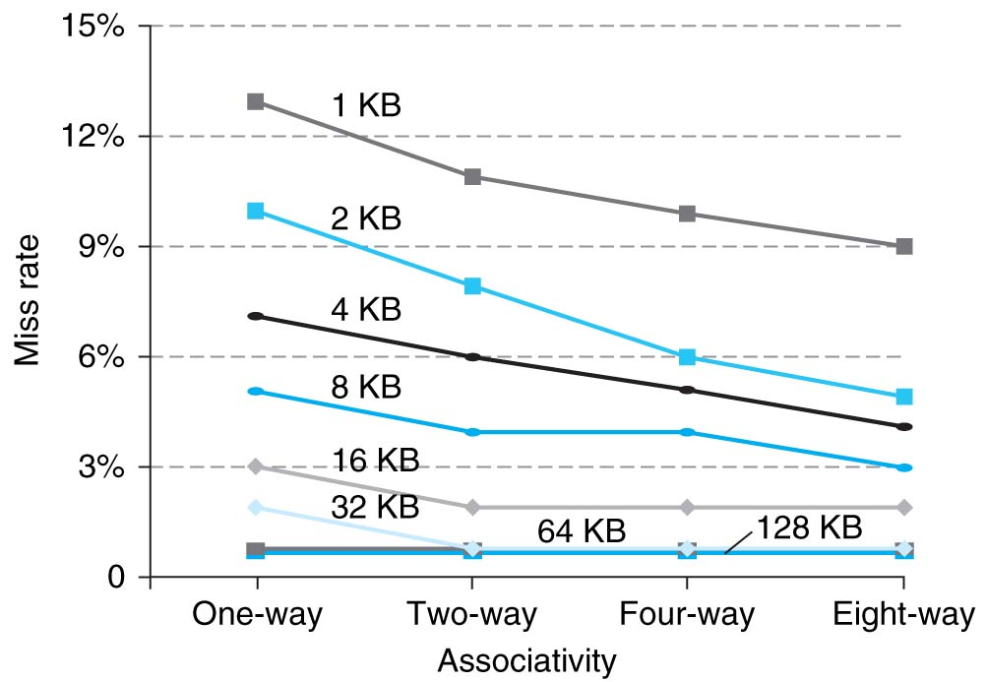
Benefits of Set-Associative Caches
Choice of DM $ versus SA $ depends on the cost of a miss versus the cost of implementation
Largest gains are in going from direct mapped to 2-way (20%+ reduction in miss rate)
Notes:
As cache sizes grow, the relative improvement from associativity increases only slightly; since the overall miss rate of a larger cache is lower, the opportunity for improving the miss rate decreases and the absolute improvement in miss rate from associativity shrinks significantly.

Slide 69
Reduce AMAT
Reduce hit time
e.g., smaller cache, lower associativity
Reduce miss rate
e.g., larger cache, higher associativity
Reduce miss penalty
e.g., multiple-level cache hierarchy
Need to balance cache parameters (Capacity, associativity, block size)

Slide 70
Recall: Sources of Cache Misses (3 C’s)
Compulsory: cold start, first access to a block
Misses that would occur even with infinite cache
Can be reduced by increasing block size
Capacity: cache is too small to hold all data needed by the program
Misses that would occur even under perfect replacement policy
Can be reduced by increasing cache capacity
Conflict: collisions due to multiple memory addresses mapped to same cache set
Recall the ping-pong cache example
Can be reduced by increasing associativity and/or increasing cache capacity
Notes:
Compulsory misses are cache misses due to cold start. You cannot avoid them but if you are going to run billions of instructions anyway, compulsory misses usually don’t bother you.
Conflict misses are misses caused by multiple memory location being mapped to the same cache location.
The nightmare scenario is the ping pong effect when a block is read into the cache but before we have a chance to use it, it was immediately forced out by another conflict miss.
You can reduce Conflict misses by either increase the cache size or increase the associativity, or both.
Finally, Capacity misses occurs when the cache is not big enough to contains all the cache blocks required by the program. You can reduce this miss rate by making the cache larger.
(Capacity miss) That is the cache misses are due to the fact that the cache is simply not large enough to contain all the blocks that are accessed by the program.
The solution to reduce the Capacity miss rate is simple: increase the cache size.
Here is a summary of other types of cache miss we talked about.
First is the Compulsory misses. These are the misses that we cannot avoid. They are caused when we first start the program.
Then we talked about the conflict misses. They are the misses that caused by multiple memory locations being mapped to the same cache location.
There are two solutions to reduce conflict misses. The first one is, once again, increase the cache size. The second one is to increase the associativity.
For example, say using a 2-way set associative cache instead of directed mapped cache.
But keep in mind that cache miss rate is only one part of the equation. You also have to worry about cache access time and miss penalty. Do NOT optimize miss rate alone.
Finally, there is another source of cache miss we will not cover today. Those are referred to as invalidation misses caused by another process, such as IO , update the main memory so you have to flush the cache to avoid inconsistency between memory and cache.
+2 = 43 min. (Y:23)

Slide 71
Effect of Cache Parameters on Performance
Larger cache size
reduces capacity and conflict misses
Increases hit time
Higher associativity
reduces conflict misses, and the overall miss rate
increases hit time
Larger block size
reduces compulsory misses
increases conflict misses and miss penalty
Notes:
Requested line first….
The following could be in the slide…
spatial locality reduces compulsory misses and capacity reload misses
fewer lines may increase conflict miss rate
larger lines may increase miss penalty
Larger block size
reduces compulsory and capacity misses

Slide 72
Improving Cache Performance
AMAT = Hit time + Miss rate x Miss penalty
Cache Size
Reduce hit time
e.g., smaller cache, lower associativity
Reduce miss rate
e.g., larger cache, higher associativity
Reduce miss penalty
e.g., multiple-level cache hierarchy
Optimal choice is a compromise
Depends on access characteristics
Workload
Use (I-cache, D-cache)
Depends on technology / cost
(Associativity)
Block Size
Bad
Good
Factor A
Factor B
Less
More
Notes:
Computer architects expend considerable effort optimizing the cache hierarchy
Several interacting dimensions
Cache size
Block size
Associativity
Write-through vs. write-back
Write-allocate vs write-no-allocate
Replacement policy (for SA and FA caches)
Optimal choice is a compromise
Depends on access characteristics
Workload
Use (I-cache, D-cache)
Depends on technology / cost

Slide 73
Multiple Cache Levels
Main Memory
L2$
L1$
CPU
Mem
Access
Miss
Hit
Miss
Hit
Path of Data Back to CPU
L1 cache size < L2 cache size << memory size

Slide 74
Local vs. Global Miss Rates
Local miss rate – the fraction of references to one level of a cache that miss
L2 Local Miss Rate = L2 Misses / L1 Misses
Global miss rate – the fraction of references that miss in all levels of caches and must go to memory, e.g., with 2-level cache hierarchy:
Global Miss rate = L2 Misses / Total Accesses
= (L2 Misses / L1 Misses) × (L1 Misses / Total Accesses)
= L2 Local Miss Rate × L1 Local Miss Rate
With L1 cache only:
AMAT = Hit Time + Miss rate × Miss penalty
With 2-level cache hierarchy (L1+L2):
L1 Miss Penalty = L2 AMAT; L2 Miss Penalty = Memory access time
AMAT = L1 Hit Time + L1 Local Miss rate × (L2 Hit Time + L2 Local Miss rate × L2 Miss penalty)
With 3-level cache hierarchy (L1+L2+L3):
L1 Miss Penalty = L2 AMAT; L2 Miss Penalty = L3 AMAT; L3 Miss Penalty = Memory access time
AMAT = L1 Hit Time + L1 Local Miss rate × (L2 Hit Time + L2 Local Miss rate × (L3 Hit Time + L3 Local Miss rate × L3 Miss penalty))

Slide 75
AMAT Example
L1 Hit Time: 1 cycle, L1 Miss Rate: 2%
L2 Hit Time: 5 cycles, L2 Miss Rate: 5%
Main Memory access time: 100 cycles
No L2 Cache:
AMAT = 1 + .02*100 = 3
With L2 Cache:
AMAT = 1 + .02*(5 + .05*100) = 1.2

Slide 76
Multilevel Cache Considerations
Different design considerations for L1 Cache and LLC (Last Level Cache)
L1 Cache design should focus on fast access: minimize hit time to achieve shorter clock cycle, e.g., with smaller size, lower associativity; miss penalty is small thanks to L2 and lower caches, so higher miss rate is OK
LLC design should focus on low miss rate: miss penalty due to main memory access is very large, e.g., with larger size, higher associativity
c.f., Slide “Associativity in the Memory Hierarchy”
Notes:
Global miss rate – the fraction of references that miss in all levels of a multilevel cache. The global miss rate dictates how often we must access the main memory.
Local miss rate – the fraction of references to one level of a cache that miss
For the L2$, fast hit time is less important than low miss rate
L2$ hit time determines L1$’s miss penalty
L2$ local miss rate >> global miss rate
Miss penalty of L1$ is significantly reduced by presence of L2$, so can be smaller/faster even with higher miss rate
\
Use multiple cache levels
2, 3 cache levels are common
High-end server may have ~1GB L4 cache off-chip

Slide 77
Summary
Cache – copy of data in lower level of memory hierarchy
Principle of locality:
Program likely to access a relatively small range of memory addresses at any instant of time.
Temporal locality vs. spatial locality
Cache organizations:
Direct Mapped: 1 block per set
N-way Set Associative: N blocks per set, N possible places in cache to hold a given memory block
Fully Associative: all blocks in 1 set
Increasing associativity helps to reduce miss rate, but increases runtime overhead
Calculation of AMAT
Three major categories of cache misses:
Compulsory Misses; Conflict Misses; Capacity Misses
Multi-level caches
Optimize 1st level to minimize hit time
Optimize last level to minimize miss rate
Lots of cache parameters (large design space)
Block size, cache size, associativity, etc.
Notes:
write-back vs. write through,
Direct Mapped to find block in cache using Tag field and Valid bit for Hit Memory block maps into more than 1 cache block

